Slide 1




Outline and Description of E3ME-FTT model
FTT Seminar(1)
April 8, 2018
Nagoya University
Presented by
Soocheol Lee (Meijo University)

Slide 2
1.Introduction to E3 modelling

Slide 3
1.1
By Prof. Neil Strachan, UCL Energy Institute

Slide 4

Simulation model: Basic information flow
Model
Impacts
Policy
Representation of behaviour
Gap between real world and
models

Slide 5
1.2
By Prof. Neil Strachan, UCL Energy Institute

Slide 6
1.3
By Prof. Neil Strachan, UCL Energy Institute

Slide 7
1.4

Slide 8
1.5

Slide 9
1.6

Slide 10
1.7 Examples of models
Equilibrium
Non-Equilibrium
GEM-E3*
WorldScan*
E3ME*
GINFORS*
General
Partial
PRIMES (energy)
TIMES (energy)
ASTRA (transport)
POLES (energy)
* These models cover the World
Notes:
HP

Slide 11
GEM-E3 E3ME
1.8 comparing GEM-E3(CGE) and E3ME(Macro Econometirc)
perfect competition
constant returns to scale
equilibrium solution
full employment
projection based on one year's data
guess-estimated parameters
varying competition over sectors
varying returns to scale
product supply-demand balance
unemployment
projection based on 40+years' data used for econometric estimation

Slide 12
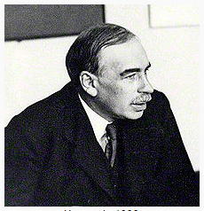
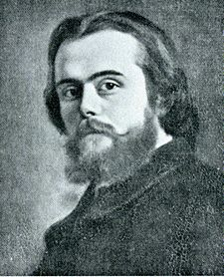
Keynes v.s. Walras
https://en.wikipedia.org/wiki/John_Maynard_Keynes
https://en.wikipedia.org/wiki/L%C3%A9on_Walras

Slide 13
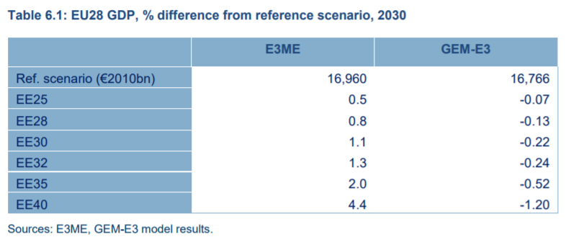
1.9 In a real-world policy simulation
2015 report, European Commission, DG ENER:
http://ec.europa.eu/energy/sites/ener/files/documents/CE_EE_Jobs_main%2018Nov2015.pdf
Increasing levels of ambition for energy efficiency in the EU
Macro Econometric model results
CGE model results
NB both the E3ME and GEM-E3 models have been developed substantially since 2015

Slide 14
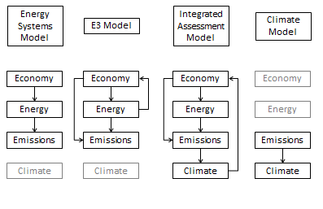
1.10 Model Linkages
Cambridge Econometrics and SERI (2011), for DG Environment

Slide 15
2.E3ME Description

Slide 16
2.1 E3ME Model(Energy-Environment-Economy Macro Econometric Model)
Macro-Econometric Model
developed by Cambridge Econometrics
・Demand driven
・No equilibrium, Non optimization
・Four East Asian regions are in the model;E3ME-Asia
・Based on data from past 40 years and OECD/IEA forecast

Slide 17
2.2 History of E3ME
The E3ME model and its predecessors
have been around since 1970s and it is
one of the most well-known econometric
models in Europe and recently globally.
1978 Spin-off from the University of Cambridge Department of Applied Economics
Origins in the ‘Growth Project’ led by Nobel Laureate Prof Sir Richard Stone
pioneered the development of detailed sectoral modelling in an input-output framework MDM
Early 1990s Expansion of scope of CE’s work to
European Regional
UK Energy, Environment and Economy service
More tailored project work
Company grows from 10 to 25 staff.
2003 CE 25th anniversary. Terry Barker sets up charitable trust fund to ensure CE's independence and principles.
New Thinking in Economics:
‘to advance education in the field of economics for the benefit of the public’
1975
1980
1990
2000
2010
1985
1995
2005
Early stage of the company
Product and model developments
The move to more consultancy projects
1980s CE’s work focuses mainly on annual subscription services
UK Industrial service
UK Regional service
and selected projects, notably the EC-funded HERMES project (in effect, a predecessor for E3ME)
Today 40 staff based in Cambridge. International reputation in the application of whole-economy, sectoral modelling, particularly the global E3ME model
1993 Start of part-EC funded research project to build E3ME
It is used for official analysis for the
European Commission (including the
recent Clean Energy Package and
Climate and Energy Framework 2030).

Slide 18
2.3 The E3ME model: Dimensions
Econometric model
  cover world 59 regions, including explicit representation of all G20 countries and all EU Member States. The model has recently been expanded to cover many East Asia and South East Asia regions explicitly including Japan, China, Korea, Taiwan and Indonesia. Other ASEAN countries are grouped together.
  based on the system of national accounts
    includes intermediate and all components of final demand
    detailed treatment of the labor market
    22 stochastic equation sets, also covering energy and prices
  large sectoral disaggregation: 42 industries, 28 consumption categories
  12 different fuel types, and 23 separate fuel user groups ,24power technologies
  14 atmospheric emissions
  long and short-term specification
  annual solutions to 2050
For more details see www.e3memodel.com

Slide 19
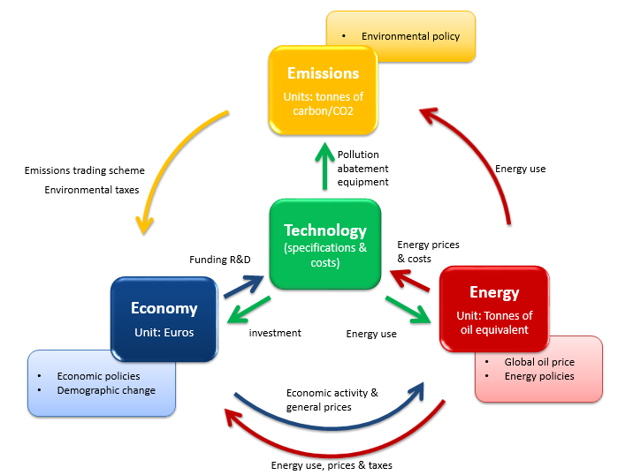

2.4 Simple structure of The E3ME Simulation Model

Slide 20
2.5 The stochastic equation sets
Energy equations
Shares of coal, oil, gas and electricity
Aggregate energy
Bilateral trade
Industrial investment
Industrial prices
Export and import prices
Aggregate and shares of household consumption
Material use
Normal output
Labour market participation rate
Investment in dwellings
Residual income (non-employment)
Industrial average earnings
Hours worked
Industrial employment
Labour market equations
Trade equations
Price and wage equations

Slide 21
2.6 Exogenous variables
Population
Natural resources (including coal, oil and natural gas, raw commodity price)
Current and capital spending of government
Tax rates and allowances
Exchange rates
Short- and long-term interest rates
World prices of traded goods, e.g. crude oil

Slide 22
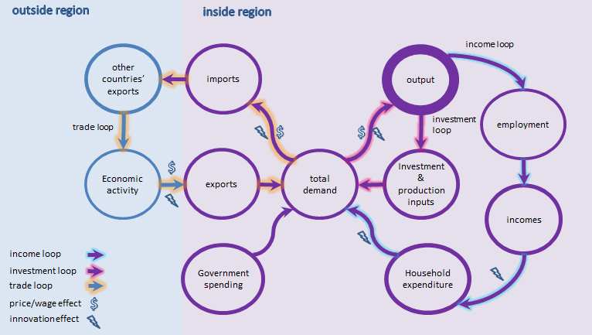
2.7 The determination of output in E3ME
Notes:
The diagram provides an alternative representation of the relationships embodied in the model. The chart shows two loops or circuits of economic interdependence:
the output-investment loop
the output-income loop.
The regionalised model contains a third loop between UK regions and the national economy.
The output-investment loop
includes industrial demand for goods and services and runs from total demand to output and then to investment and back to total demand. Total demand for the gross output of goods and services is formed from industrial demand, household expenditure, government demand, investment (fixed domestic capital formation and stockbuilding) and exports. These totals are divided between imports and output depending on relative prices, levels of activity and utilisation of capacity.
The output-income loop
In this loop, industrial output generates employment and incomes, which lead to household expenditure, thereby adding to total demand. Changes in output are used to determine changes in employment, along with changes in real wage costs (explained by price levels and conditions in the labour market), interest rates and energy costs.
For example, an increase in export demand for UK-produced cars (most cars manufactured in the UK are for export) leads to an increase in total demand, resulting in both an increase in imports (eg of component parts) and an increase in UK output. The increase in domestic output will be reflected in increased employment (depending on the extent to which the demand can be met by boosting productivity), which in turn leads to increased incomes, generating higher household expenditure on goods and services and growth in total demand. Some of this demand will be met by imports and some by domestic suppliers, and so on...

Slide 23
2.8 The core input-output structure Connected by I-O table
Industries
Products
Input-Output Table
Household Final Consumption
Government Final Consumption
Fixed Investment
Change in Inventories
Exports
Total Demand
Imports
Domestic Supply
+
+
+
+
+
=
=
+
Value Added: wages
profits deprecation
+
Taxes and Subsides
=
Gross Output

Slide 24
2.9 Energy and emission classifications in E3ME Version 6
FU:23 (fuel users)
Power Generation
Own use
Hydrogen production
Iron & Steel
Non-ferrous Metals
Chemicals
Mineral Products
Ore-extraction
Food, Drink & Tob.
Tex., Cloth. & Foot.
Paper & Printing
Engineering etc
Other Industry
J:12 (fuels)
Hard coal
Other coal etc
Crude oil etc
Heavy fuel oil
Middle distillates
Other gas
Natural gas
Electricity
Heat
Combustible waste
Biofuels
Hydrogen
EM:14 (air emissions)
CO₂
SO₂
NO_{X}
CO
Methane
Black smoke
VOC
Nuclear - air
Lead - air
CFCs
N₂O (GHG)
HF₆ (GHG)
PFC (GHG)
SF₆ (GHG)
14. Construction
15. Rail Transport
16. Road Transport
17. Air Transport
18. Other Transport serv.
19. Households
20. Agriculture, forestry, etc.
21. Fishing
22. Other Final Users
23. Non-energy use

Slide 25
2.10 Energy and emission classifications in E3ME Version 6
Road transport technology
1 Petrol Econ
2 Petrol Mid
3 Petrol Lux
4 Adv Petrol Econ
5 Adv Petrol Mid
6 Adv Petrol Lux
7 Diesel Econ
8 Diesel Mid
9 Diesel Lux
10 Adv Diesel Econ
11 Adv Diesel Mid
12 Adv Diesel Lux
Power technology
1 Nuclear
2 Oil
3 Coal
4 Coal + CCS
5 IGCC
6 IGCC + CCS
7 CCGT
8 CCGT + CCS
9 Solid Biomass
10 S Biomass CCS
11 BIGCC
12 BIGCC + CCS
13 Biogas
14 Biogas + CCS
15 Tidal
16 Large Hydro
17 Onshore
18 Offshore
19 Solar PV
20 CSP
21 Geothermal
22 Wave
23 Fuel Cells
24 CHP
13 LPG Econ
14 LPG Mid
15 LPG Lux
16 Hybrid Econ
17 Hybrid Mid
18 Hybrid Lux
19 Electric Econ
20 Electric Mid
21 Electric Lux
22 motorcycles Econ
23 motorcycles Lux
24 Adv motorcycles Econ
25 Adv motorcycles Lux

Slide 26
2.11 Treatment of Technology
It is now generally accepted that technology should be endogenous in modelling
There are two ways of doing it
  explicitly (bottom-up, partial approaches)
  implicitly (top-down, general approaches)
There will always be a limitation that it is not possible to predict all future technologies

Slide 27
3.FTT Description and its Linkage to E3ME

Slide 28
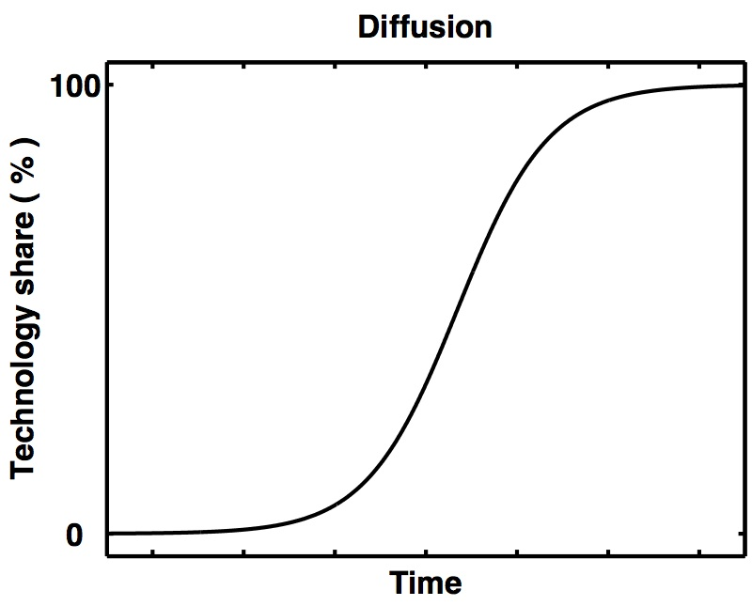
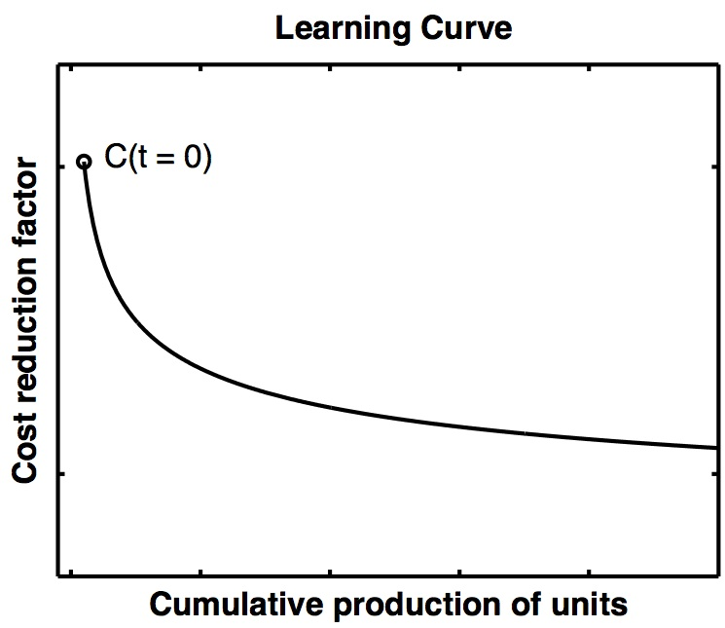
Two principles of technology dynamics
3.1 Dynamics of technology substitution
Going beyond optimisation:

Slide 29
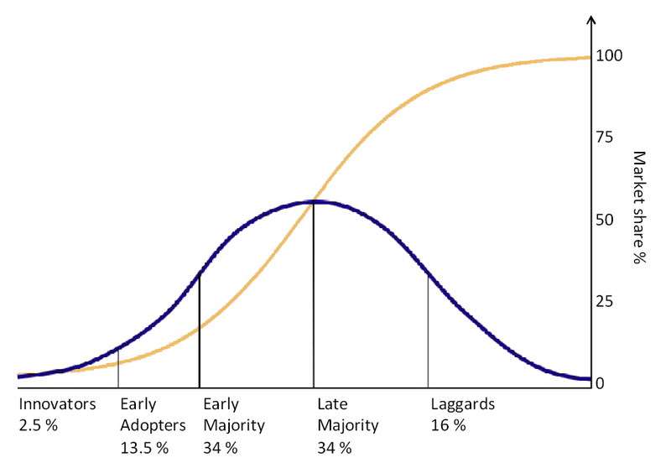
This abstract concept of technology diffusion
Wikipedia “Technology Diffusion”
See Technology and Global Change by Grubler

Slide 30
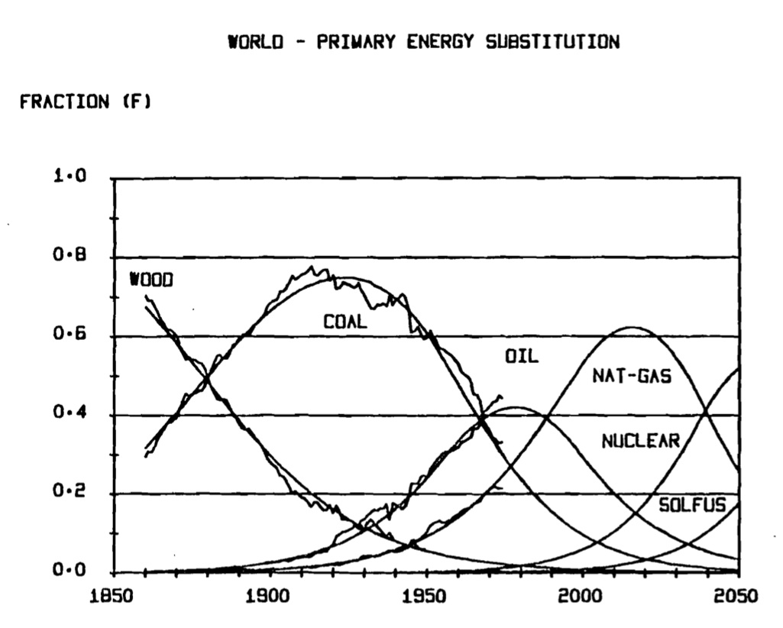
Historical evolution of energy use
Marchetti & Nakicenovic Tech. Rep. IIASA (1978)
See also Technology and Global Change by Grubler

Slide 31
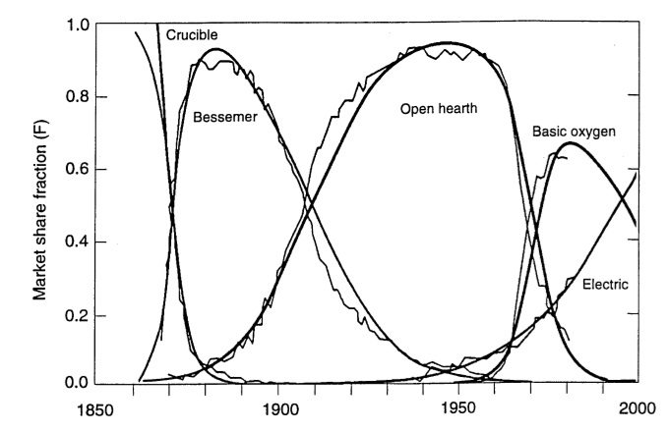
Historical change in infrastructure and methods
Infrastructure:
e.g.
Steel production:
Grubler, Nakicenovic, Victor, Energy Policy 1999

Slide 32
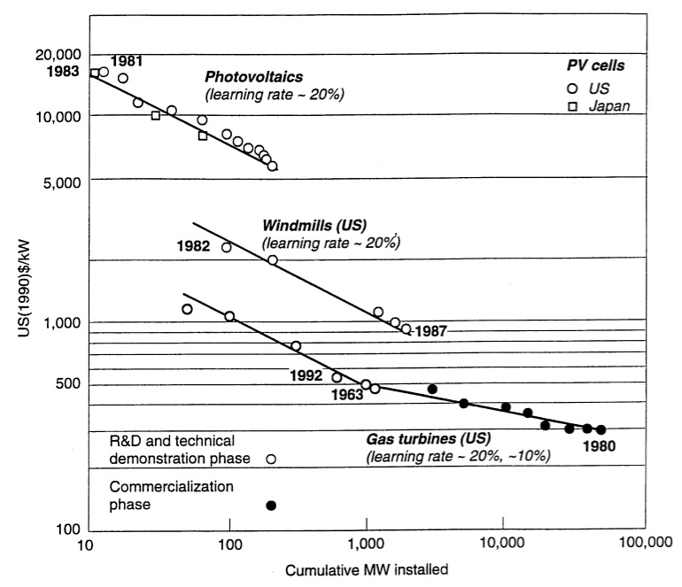
Empirical learning-by-doing
Grubler, Nakicenovic, Victor, Energy Policy 1999

Slide 33
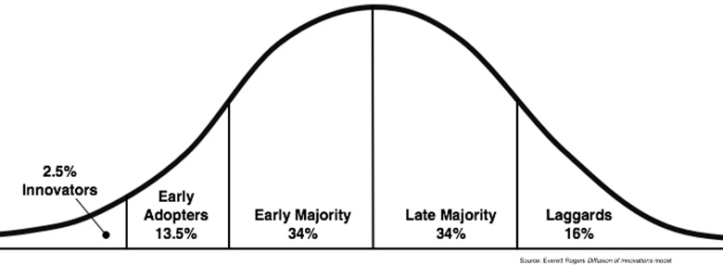
Technological learning and cost impact
Adoption rate
Time
Cost
Diffusion and learning interact
Time

Slide 34
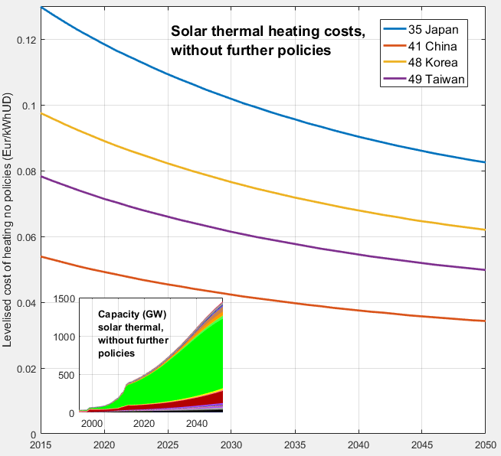
Technological learning and cost impact
By Florian Knobloch
FTT:Heat simulation of future solar thermal heating costs, by country
(assuming a continuation of current policies).

Slide 35
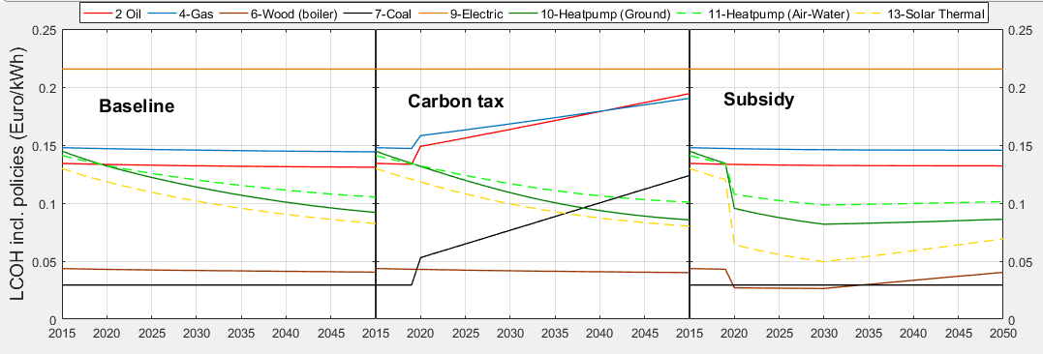
Policy effects on heating costs in Japan
By Florian Knobloch
Technological learning mainly reduces cost of
solar thermal, heat pumps and modern biomass.
The carbon tax increases the cost of coal, oil
and gas-bases heating.
The subsidy decreases the cost of renewables. Although
it is phased out after 2030, costs remain at a much lower
level, due to technological learning in the meantime.

Slide 36
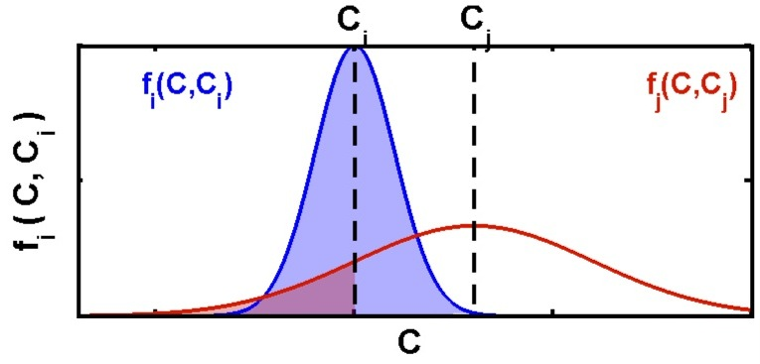
3.2 Defining a driver for technology substitutions
Separating choice from industrial dynamics:
Probabilistic Choice matrix:
J.-F. Mercure, Energy Policy 48, 799-811 (2012)

Slide 37
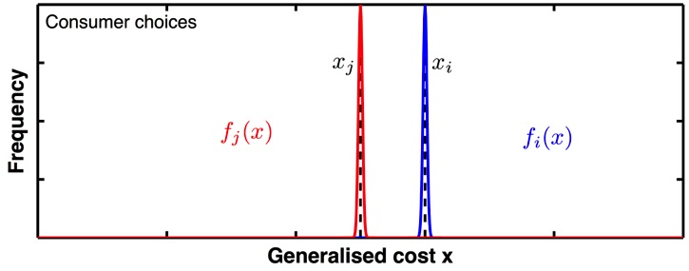
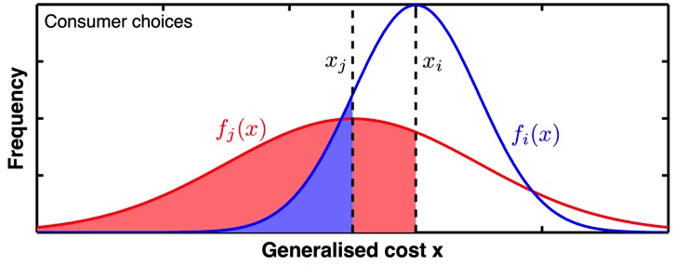
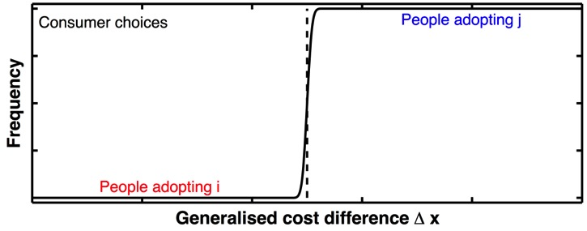
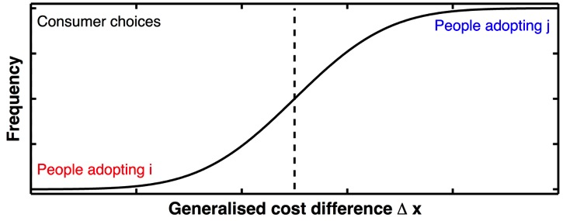
J.-F. Mercure, Energy Policy 48, 799-811 (2012)
Choice probability distribution depends on cost distribution
Choice probability represents diversity of investors
※Δx=xi-xj
0
0
Power sector replace their generation systems in time intervals related to technical lifetimes
Choices are based on Levelised Costs of power Generation (LCOG):
combined measure of investment costs, fuel costs, and maintenance costs
Calibration of these costs to observed preferences and trends:
accounts for lead times of constructions, different comfort levels, local variations, existing policies etc.

Slide 38
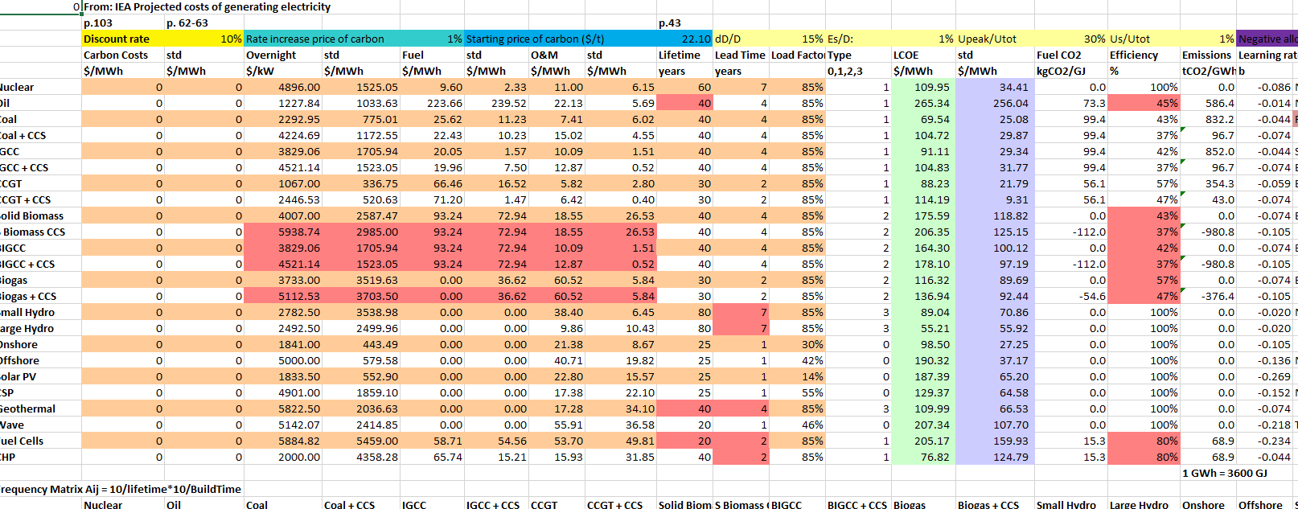
FTT-Power (LCOE – IEA 2016)

Slide 39
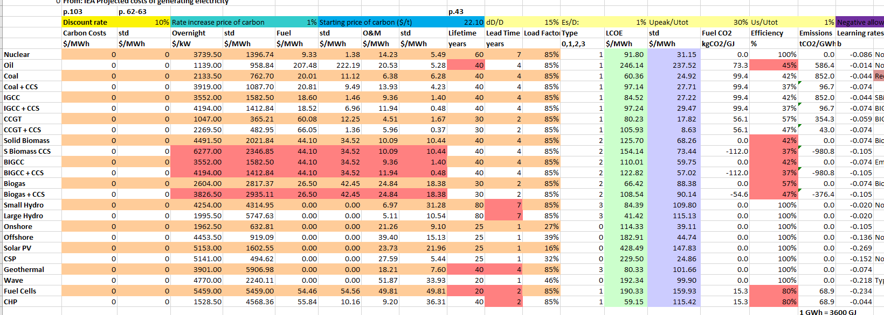
FTT-Power (old LCOE – IEA 2010)

Slide 40
FTT-Power (new LCOE - implications)
Solar and onshore winds now take off more easily even with low carbon price
FIT for these renewable technologies are no longer effective as they are already competitive

Slide 41
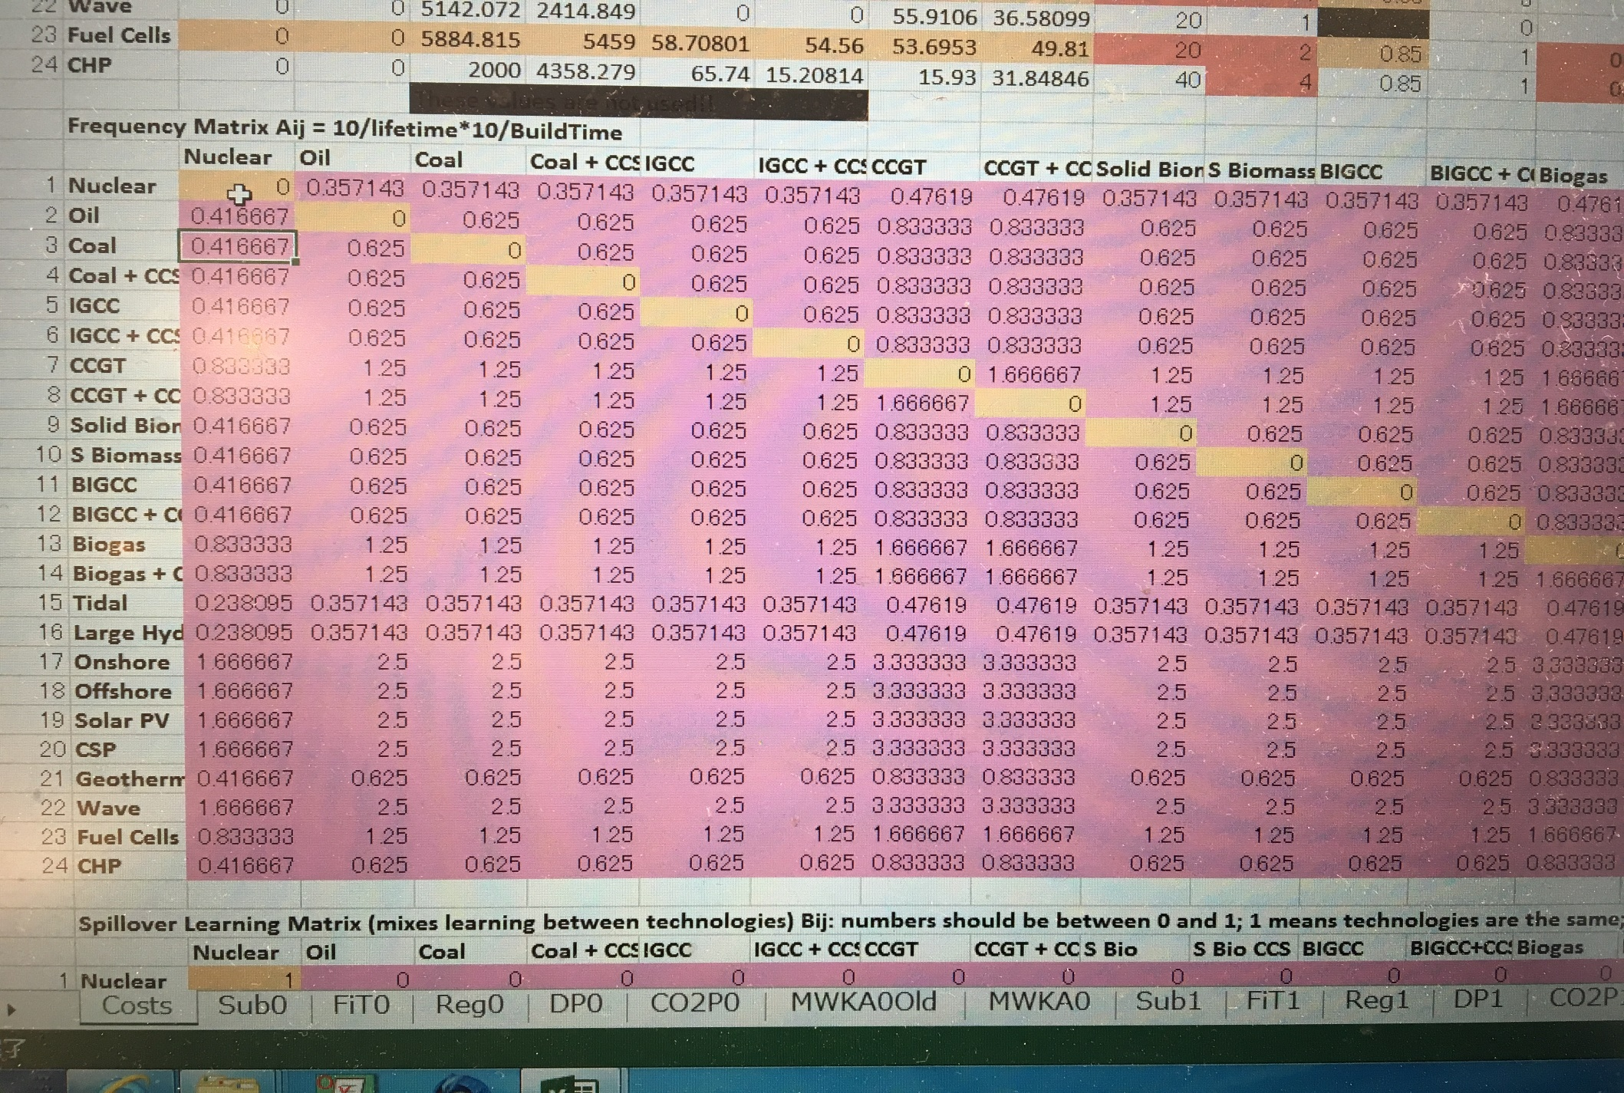
FTT Power Frequency Matrix Aij = 10/lifetime*10/Build Time

Slide 42
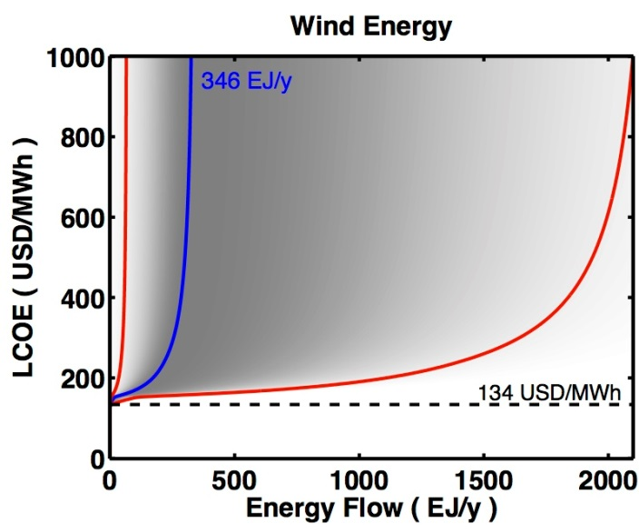
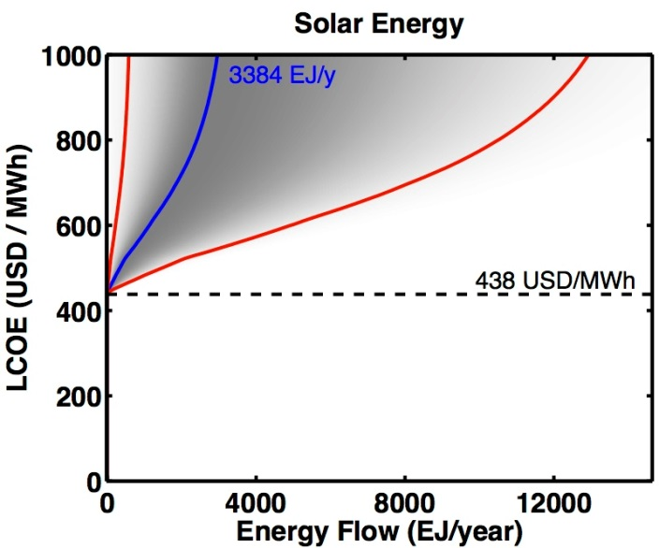
FTT: Power
Cost-Supply Curve
= Natural resource availability
Mercure & Salas, Energy 46, 322-336 (2012)
・Cost increases as the technology diffuses
since less resource being available
・Learning effect from cumulative capacity

Slide 43


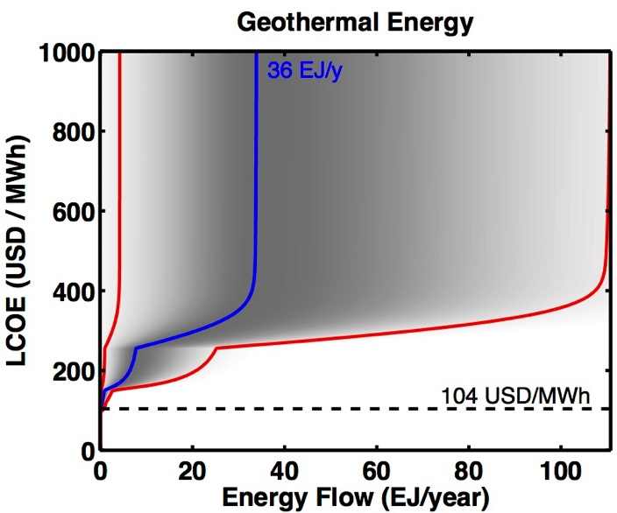
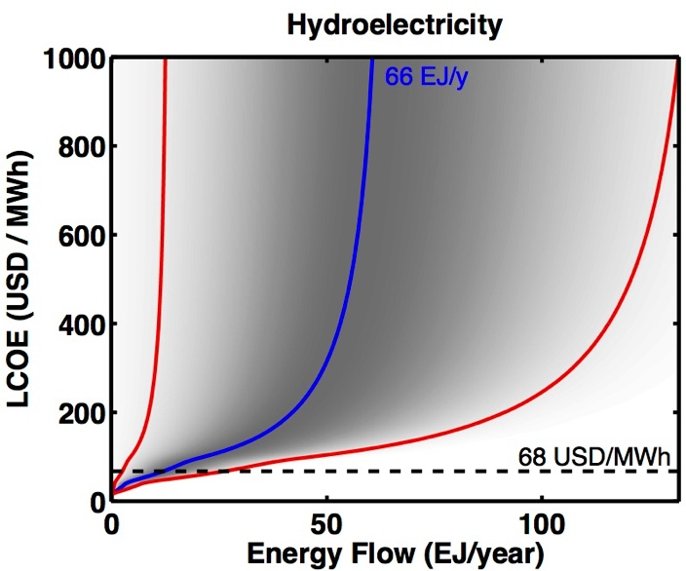
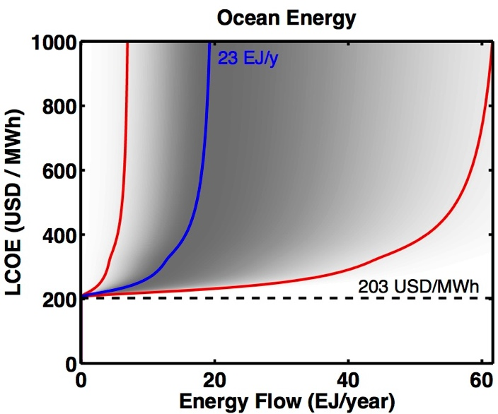
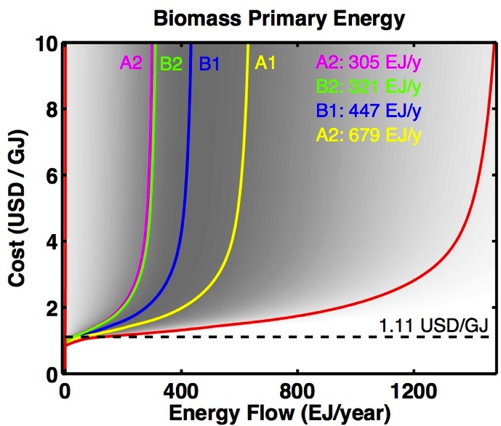
Cost-supply curves for renewables

Slide 44
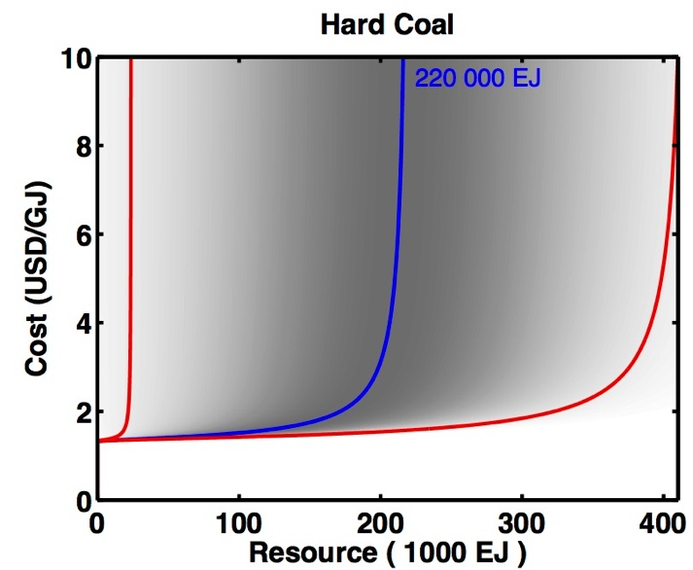
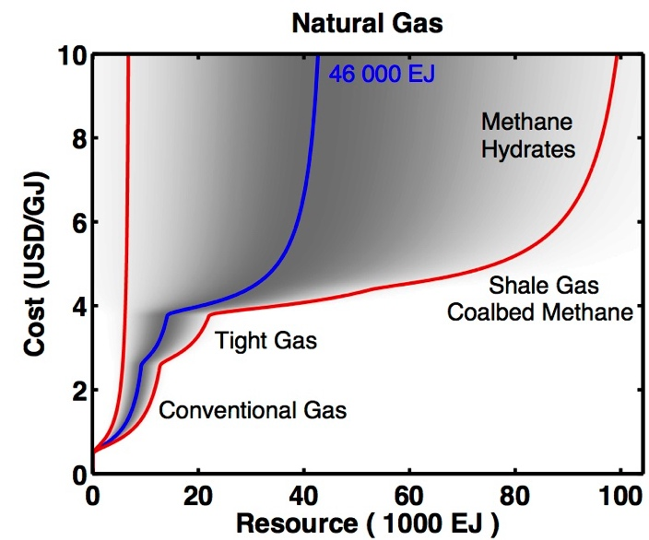
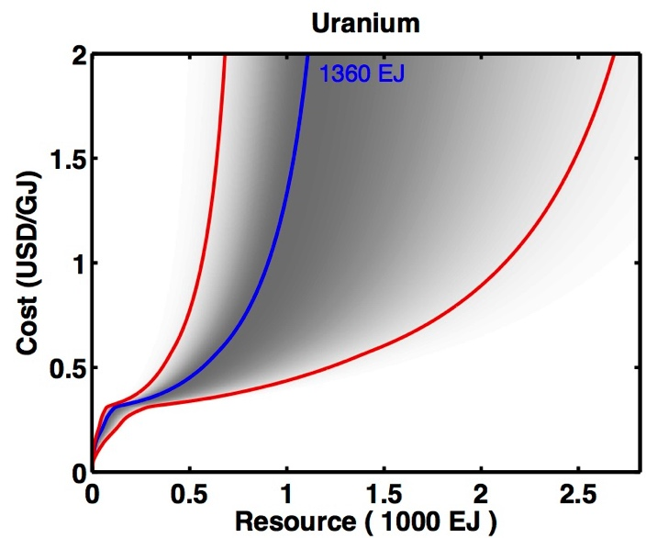
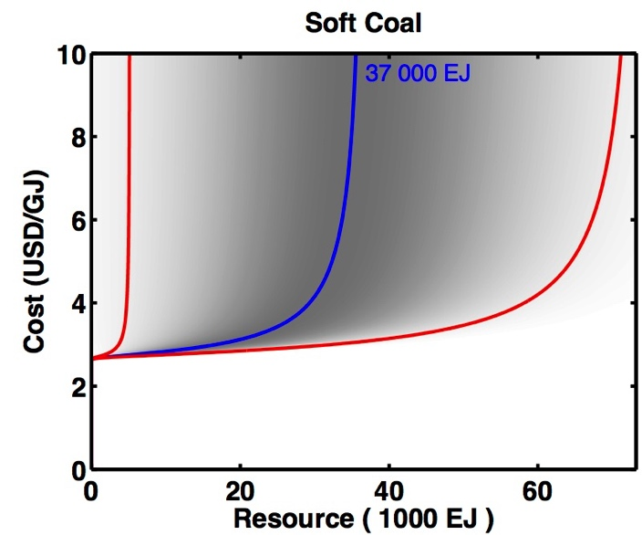
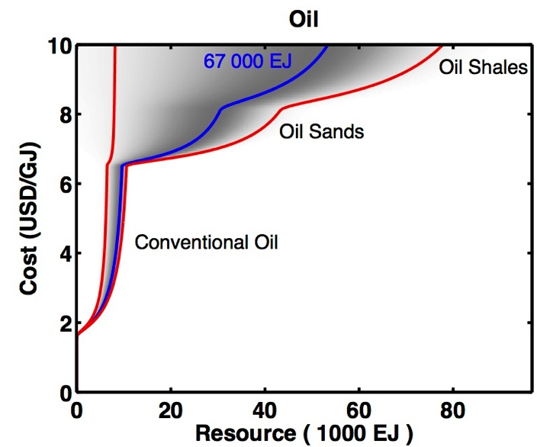
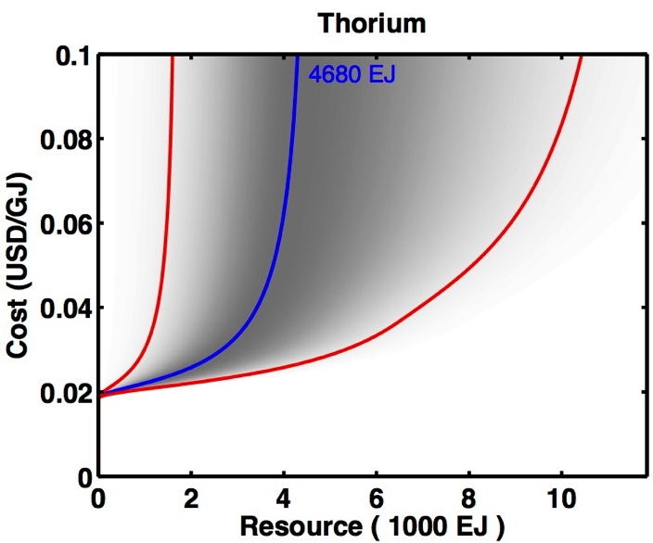
Cost-quantity curves for fossil & nuclear fuels

Slide 45
Work on natural resources

Slide 46
Modeling technology substitution
FTT: Power
Simulates:
The future replacement and diffusion
Of power technologies
By power generation sectors worldwide
(59 world regions)
Based on dynamical shares equations (the FTT method – no optimisation)
Useful energy demand by country as an exogenous driver (depending on future levels of construction/gereration)
Substitutions
Substitutions
Coal
Coal
Coal
CCGT
CCGT
CCGT
…
Hydro
Hydro
Hydro
Wind
Wind
Wind
PV
PV
PV
BIGCC
BIGCC
BIGCC
…
…
…
t = 1
t = 2
t = 3
J.-F. Mercure, Energy Policy 48, 799-811 (2012)

Slide 47
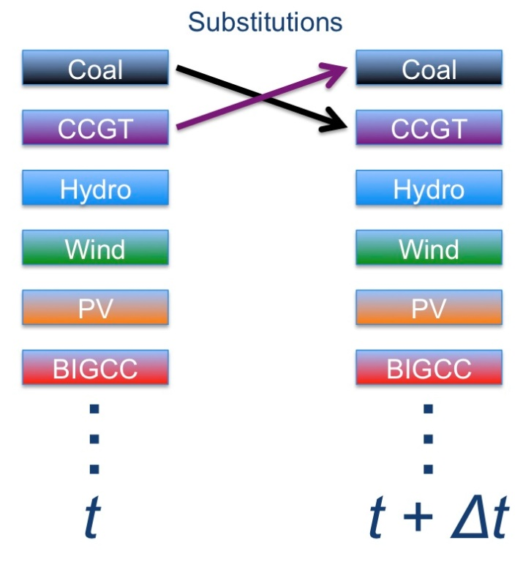
Substitution process
S_{i}: Market Shares
F_{ij} drives a flow of substitutions between i and j :
Growth rate
Scrappage rate
J.-F. Mercure, Energy Policy 48, 799-811 (2012)

Slide 48
FTT: Power
Technology shares determined by
Aggregating every choices
J.-F. Mercure, Energy Policy 48, 799-811 (2012)
Si : Share of technology i
Aij : Life time of technology i and lead time of technology j
Fij : Probability that technology i would be chosen between i and j
t : time

Slide 49
Projections of global electricity sector decarbonisation
Explore the impacts of energy policy instruments, individually and combined
      Carbon pricing / carbon taxing
      Feed-in tariffs for renewables
      Subsidies (e.g. gov. investing in renewables)
      Regulations (what can be built and what cannot)
      Exogenous assumptions (e.g. nuclear in Japan)

Slide 50
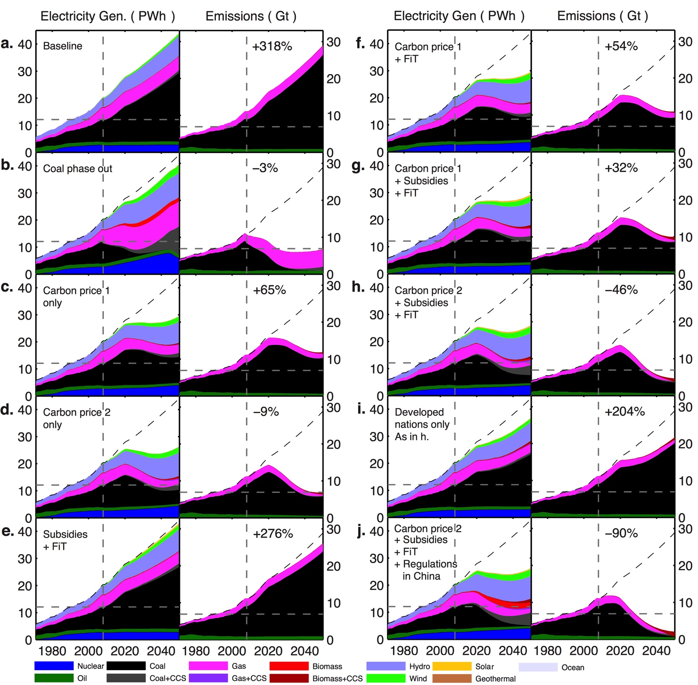
FTT

Slide 51
Global electricity decarbonisation work

Slide 52
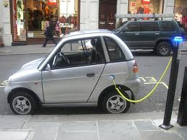
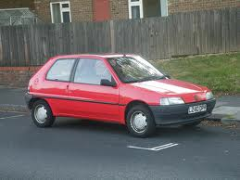
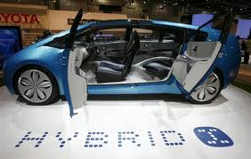
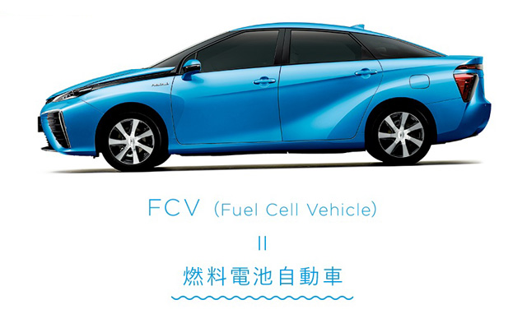
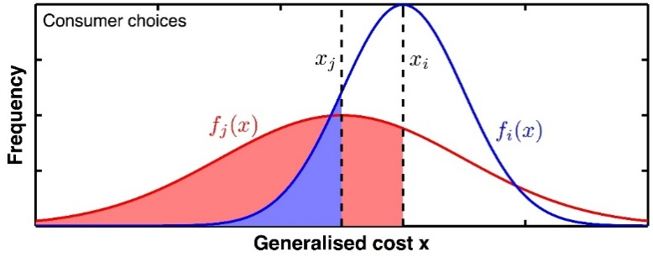
FTT : Transportation
Diffusion: technology choices
The uptake of new technology:
Innovation – Selection – Diffusion
t
t + Δt
t
J.-F. Mercure, Energy Policy 48, 799-811 (2012)
トヨタ環境2050
https://www.toyota.co.jp/jpn/sustainability/environment/challenge2050 /

Slide 53
E3ME-FTT Transport
E3ME consumption equation
car price
income
fuel price
- fuel tax
- carbon tax
car sales
distance driven
FTT-Transport
FTT transport policies*
IO feedback
average car price
car demand by technology
road transport fuel demand
road transport CO₂

Slide 54
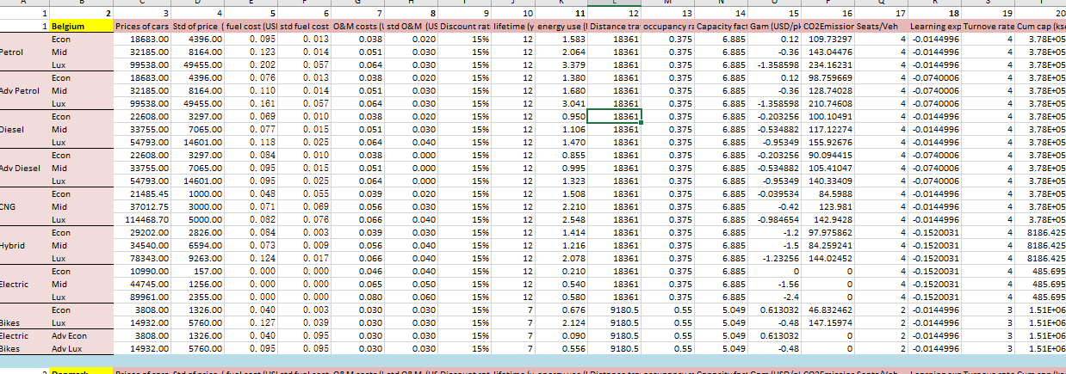
FTT-Transport
price of cars assumptions - different for each region

Slide 55
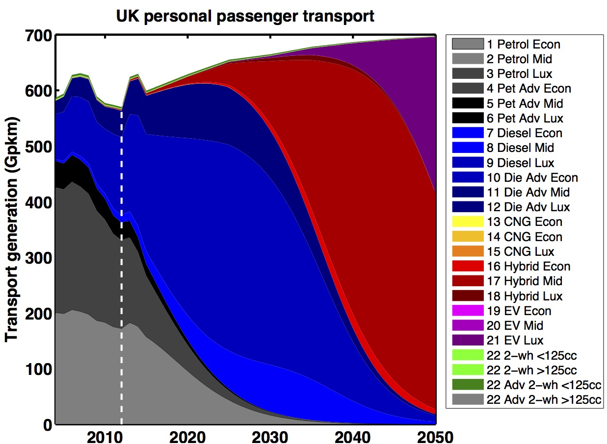

The diffusion of vehicle technology
FTT :
Transportation
  53 regions, 25 technologies
Mercure & Lam, In preparation (2016)

Slide 56
FTT :
Transportation
The effectiveness of policy on consumer choices
The effectiveness of policy on consumer choices for private road passenger transport emissions reductions in six major economies 2015
https://www.repository.cam.ac.uk/bitstream/handle/1810/247636/WorldCarFleets_ArXiv_v3.pdf?sequence=2

Slide 57
Possible policy scenarios in FTT Transport
Policies available
vehicle tax
road tax
fuel tax
carbon tax
biofuel mandate
regulations
exogenous share

Slide 58
FTT: Power Link between E3ME and FTT
FTT is a micro-model of technology choice and substitution, given economic/policy context
Post-Schumpeterian
(evolutionary)
FTT
・Fuel consumption
・Investment in
new power source
・Electricity price
・Electricity demand
・Fuel demand
E3ME
Post-Keynesian,
＝
・CO2 emission
・Investment spill over
・GDP, Employment

Slide 59
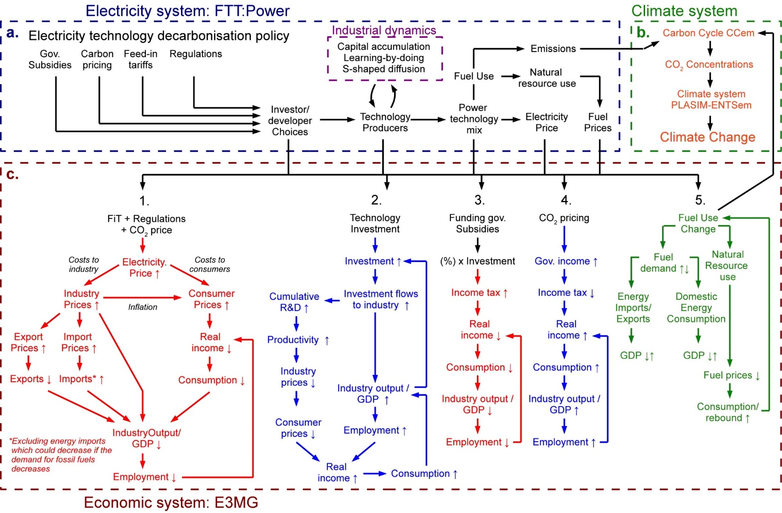
Bottom-up Schumpeterian meeting Top-down Post-Keynesian: the E3ME model
E3ME

Slide 60
4. Latest E3ME Development

Slide 61
4.1FTT-Heat(1)
Modelling residential heat decision by households
Cover all 59 regions in E3ME
FTT:Heat performs a pairwise comparison of all available heating technologies based on a single quantity, the levelised cost of heating (LCOH).

Slide 62
4.1 FTT-Heat(2)
It is the present value cost of operating a heating system during its lifetime, including investment, maintenance and fuel costs, which themselves depend on technology‐ and region‐specific conversion efficiencies and capacity factors, according to the model data.
In addition, policies can be imposed, such as a subsidy on upfront investment costs or a carbon tax.
  Carbon tax on residential sector
  Energy tax on residential sector
  ‘Kick starts’ policies e.g. regulations, subsidies

Slide 63
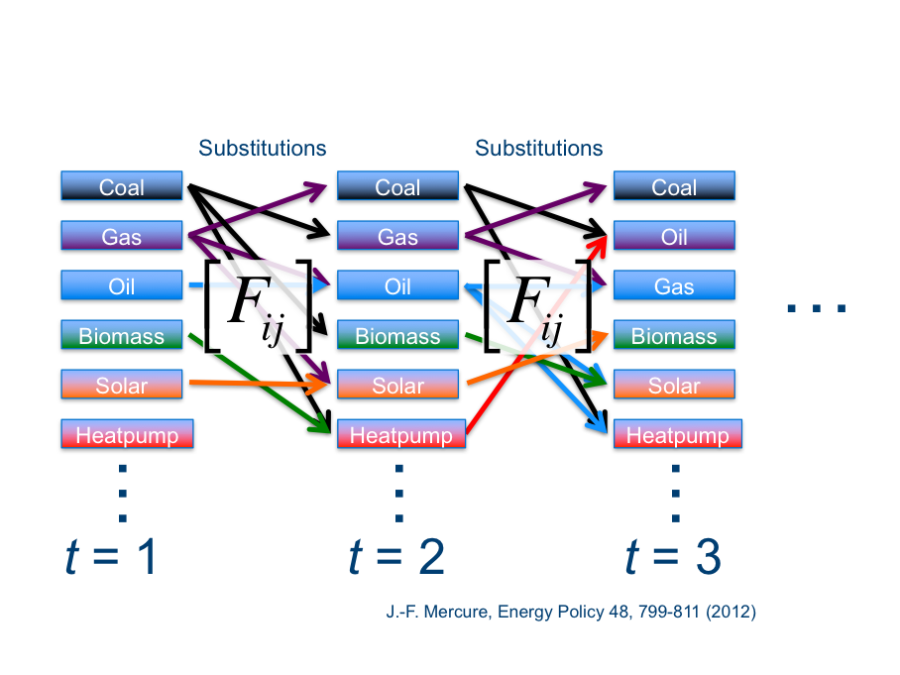
4.1 FTT:Heat(3)

Slide 64
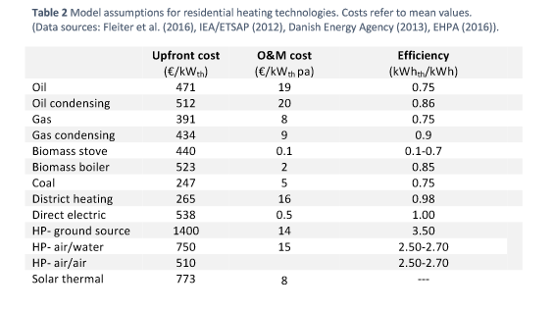
4.1FTT-Heat(4)

Slide 65
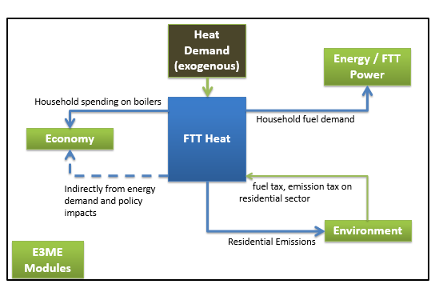
4.1 FTT-Heat(5)

Slide 66

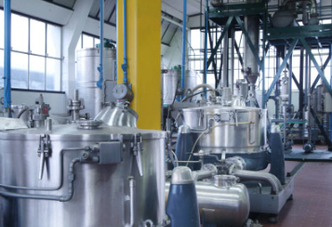
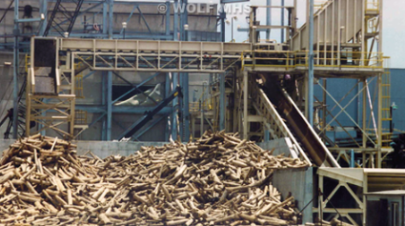

4.2 FTT Industry(1)
Similar concept as FTT-Power and FTT-Transport – technology diffusions
More complex because different industries use different production technologies
Development stage:
which industries to include?
Possible sectors: steel, chemical, petroleum, pulp and paper
・defining technologies
defining policy options
data collection
link to E3ME – inputs and feedback
  link to E3ME raw material demand?

Slide 67

4.2 Making Iron and Steel(3)
高炉の鉄鋼１トンの製造時に生じる二酸化炭素）は単純計算では約2.0kg、電気炉の鉄鋼は約0.５kgになるので、二酸化炭素排出量は電気炉のほうが高炉より約1/4節約可能となる

Slide 68

4.2E3ME-FTT Industry(3)
MOE stands for Molten Oxide Electrolysis, BF TGR for Blast Furnace-Top Gas Recycling, and HFS for Hydrogen Flash Smelt.
OHF (Open Hearth Furnace), BOF (Basic Oxygen Furnace) and EAF (Electric Arc Furnace) are the steelmaking technologies.
The three main routes for making steel are:
The Blast Furnace-Basic Oxygen Furnace (BF-BOF) route;
The Scrap-Electric Arc Furnace route; and
The Direct Reduced Iron-Electric Arc Furnace (DRI-EAF) route.
Scrap-EAF
HIsarna-BOF
HIsarna-BOF (CCS)
MOE-EAF
HFS-EAF
DRI-EAF (gas)
DRI-EAF (gas, CCS)
DRI-EAF (coal)
DRI-EAF (coal, CCS)
BF-OHF
BF-BOF
BF TGR-BOF (CCS)
Santamaria and Linares (2011) http://www.iit.upcomillas.es/docs/IIT-11-090A.pdf
© Xi'an Abundance Electric Technology Co.,Ltd

Slide 69


4.2 Steel making process with Hydrogen Reduction(4)

Slide 70


Slide 71



4.3 E3ME and FTT Family: Intregrated
Energy Resources
Natural resource use and depletion
E3ME-FTT-GENIE
Policy Assumptions
Economic feedbacks
Energy Prices / Resource costs
GHG Emissions
GHG Concentrations
Energy Policy
assumptions
Environmental Changes
Land productivity
LPJmL-em
Land productivity
FTT:Power
Power sector
technology model
FTT:Heat
Technological change
in residential heating
FTT:Agriculture
Competing uses
of land
FTT:Transport
Transport technology model
Global warming
Precipitation anomalies
Other climate impacts
GHG emission
Env. Impacts
E3ME
Macroeconometric model of the global economy
Climate Change/
GENIE1
Carbon cycle
GENIE1 - PLASIM
Climate system
Concentrations
Figure 1: Integration of FTT:Heat with E3ME-FTT-GENIE, a simulation-based Integrated Assessment Model for climate change policy research.^{1,2}

Slide 72
4.4 Financial treatment
Trying to capture crowding out in the financial market
Introducing sector’s debt in the investment equations (higher debt, less able to make investment)
Convert exogenous base rate of interest to endogenous commercial rate of interest – taking into account of country’s risk.
  use this new investment term in the investment equations

Slide 73
4.5 Normal output (supply constraints)
Trying to capture crowding out in the product market
Normal or expected output is an existing term in E3ME equations for industry prices, wages, investments and imports
It is a proxy for supply constraints in a demand-driven E3ME model
  e.g. the further away from normal output – the higher shock to capacity
  price, wages, investment and imports should response accordingly

Slide 74

Normal output (new specification)
New normal output = f(output of past 5 years, technologies, unemployment)

Slide 75
4.6 Development of the material module in E3ME
Originally developed for the European Matisse research project http://www.matisse-project.net/
Applied in the petrE project (Ekins et al, 2012) http://www.petre.org.uk/pdf/ExtendingE3ME_to_Material_Flows.pdf
Very few macroeconomic models currently include physical measures of material consumption
Recent work for European Commission includes resource efficiency, material tax, ETR, and circular economy
Now includes non-EU regions

Slide 76

4.7 New in E3ME: Global material modelling

Slide 77
4.8 E3ME Limitations
Data
  annual model
  quality and availability of data
Econometric
  dealing with structural change
  based on historical relationships (Lucas critique)
Complexity
  complex linkages between different part of models
Treatment of financial markets

Slide 78
“Good modelling involves the combination of best econometric practice, coherent economic theory and knowledge of data. Inevitably conflicts can arise between these three factors, and the modeller will need to exercise judgement in the weight that is attached to the econometric evidence, its consistency with theory and the requirement to model properly the time series observations”
Sean Holly (2013)

Slide 79
List of model references
Data exploration on the 4CMR website:
http://www.4cmr.group.cam.ac.uk/research/FTT/fttviewer
Definition of FTT:Power: J-F Mercure, Energy Policy, 48 799-811 (2012)
Energy resources database: Mercure & Salas, Energy, 46 322-336 (2012)
Consumption of non-renewable resources: Energy Policy, 63, 469-483 (2013)
See also 4CMR working papers: http://ideas.repec.org/p/ccc/wpaper/002.html
Technology diffusion theory: http://arxiv.org/abs/1304.3602
Electricity sector scenarios and policy analysis: Energy Policy 73 686-700 (2014)
Economic impacts of decarbonisation: http://arxiv.org/abs/1310.4403

